Slide 1

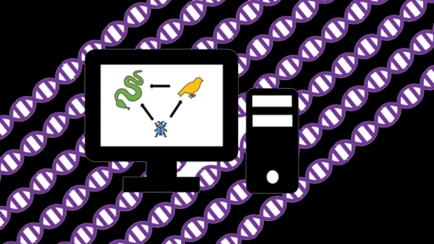

Genes and Evolution
Steve Hein & McKenna Burns
Miami University

Slide 2
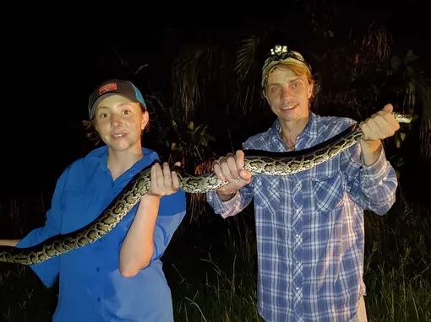
Steve
Hein
McKenna Burns

Slide 3
Steve
Hein
McKenna Burns
Snake Friend

Slide 4
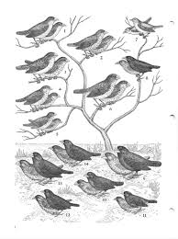
Course Overview
What is evolution?
Phylogenetics
Molecular phylogenetics
Genetic Data
Working with genetic data
Our tutorial

Slide 5
Course Overview
What is evolution?
Phylogenetics
Molecular phylogenetics
Genetic Data
Working with genetic data
Our tutorial
Probably what I should have called this course

Slide 6
Evolution
Descent with modification
Time
Notes:
Evolution happens at the population level. Populations are interbreeding groups of the same organisms.

Slide 7
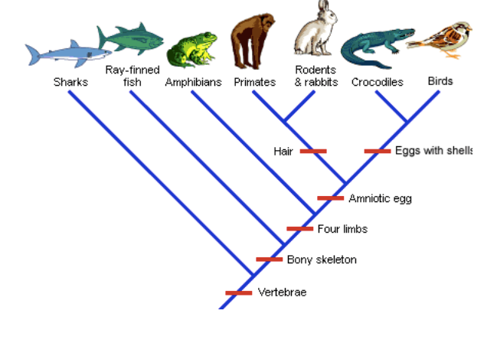
Evolution
Descent with modification
Biological evolution is the change in inherited traits over successive generations in populations of organisms
Understanding Evolution. 2020. University of California Museum of Paleontology. 8 August 2020 <http://evolution.berkeley.edu/>.
Notes:
Evolution happens at the population level. Populations are interbreeding groups of the same organisms.

Slide 8
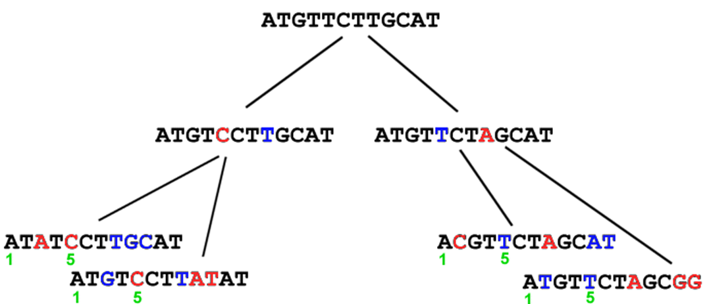
Evolution
Descent with modification
Biological evolution is the change in inherited traits over successive generations in populations of organisms
“Evolution is changed gene frequencies in populations [that’s it]” – Richard Dawkins
http://biology.kenyon.edu/courses/biol114/Chap09/Chap09.html
Notes:
Evolution happens at the population level. Populations are interbreeding groups of the same organisms.

Slide 9
What evolution is not
The sole idea of Charles Darwin
He is an extremely important figure but not the first to have these type of ideas
An attempt to understand the origin of life itself
Evolution does NOT explain the original creation of living being
Simply an attempt to understand how new species form
This is an important concept but not the only thing evolutionary biologist study

Slide 10
What does an evolutionary biologist study
Drug development
Mutation target drugs, drug resistance, epidemiology and pandemic response
Species health and conservation
Genetic information can give is very informative towards saving endangered species
Effects a of environmental and climatic change on populations
Changing environments bring populations in and out of contact with each other
Evolutionary history and relatedness of organisms
Phylogenetics

Slide 11
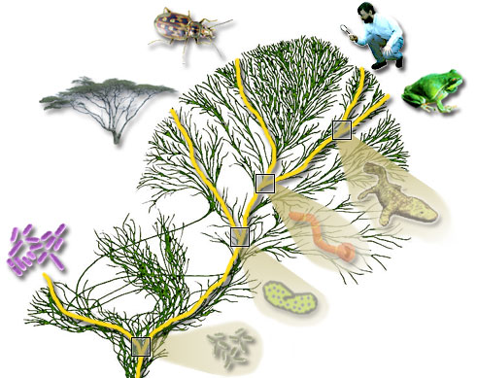
Phylogenetics
The study of evolutionary relations between groups of organisms
How are species (or other groups) related to each other?
Uses shared characteristics to help reconstruct the evolution history of organisms
http://tolweb.org/tree/learn/concepts/whatisphylogeny.html
Notes:
A major goal in the study of evolution is to understand how species are related to each other

Slide 12
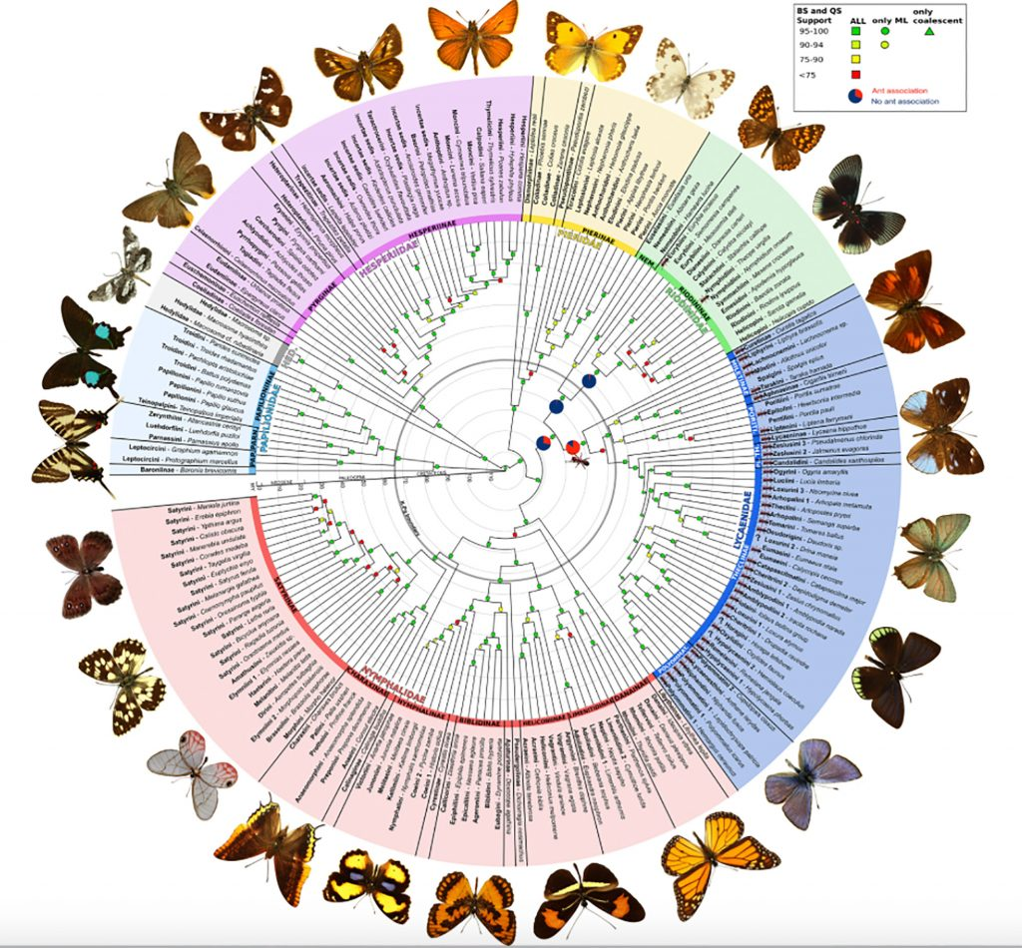
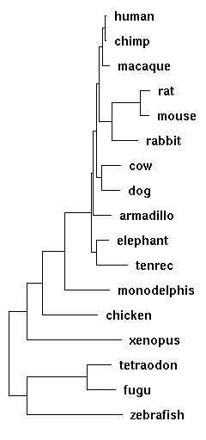
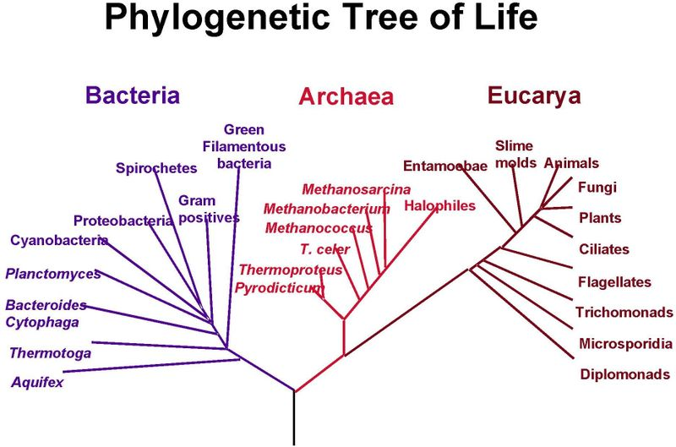
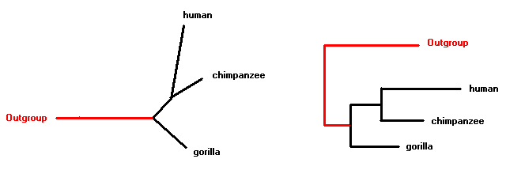
The Phylogenetic Tree
A phylogenetic tree is a diagram that is used to depict the evolutionary history or relations ships of organisms
Phylogenetic trees are hypotheses
This does not mean that they wild guesses, rather that they are an explanation that can then be tested later given further data
Espeland, M., Breinholt, J., Willmott, K. R., Warren, A. D., Vila, R., Toussaint, E. F., ... & Jarzyna, M. A. (2018). A comprehensive and dated phylogenomic analysis of butterflies. Current Biology, 28(5), 770-778.
https://www.reed.edu/biology/courses/BIO342/2012_syllabus/2012_WEBSITES/AF_rat_laughter_website/phylogeny.html
http://www.bioinf.man.ac.uk/resources/phase/manual/node59.html
https://socratic.org/questions/what-do-phylogenetic-trees-show

Slide 13
Reading Phylogenetic Tree: Key Terms

Slide 14
Reading Phylogenetic Tree: Key Terms
Taxon 1
Taxon/taxa (singular/plural): The species/individuals in your phylogeny
Taxon 2
Taxon 3
Taxon 4
Taxon 5
Taxon 6
Taxon 7

Slide 15
Reading Phylogenetic Tree: Key Terms
Taxon 1
Taxon/taxa (singular/plural): The species/individuals in your phylogeny
Leave/tips: the ends of the trees, typically your taxa.
Branches: trace the lineage of a taxa
Leaves/tips
Taxon 2
Taxon 3
Taxon 4
Taxon 5
Taxon 6
Branches
Taxon 7

Slide 16
Reading Phylogenetic Tree: Key Terms
Taxon 1
Taxon/taxa (singular/plural): The species/individuals in your phylogeny
Leave/tips: the ends of the trees. Typically your taxa.
Branches: trace the lineage of a taxa
Nodes: represent the split of two taxa from a common ancestor
Leaves/tips
Taxon 2
Taxon 3
Nodes
Taxon 4
Taxon 5
Taxon 6
Taxon 7

Slide 17
Reading Phylogenetic Tree: Key Terms
Taxon 1
Taxon/taxa (singular/plural): The species/individuals in your phylogeny
Leave/tips: the ends of the trees. Typically your taxa.
Branches: trace the lineage of a taxa
Nodes: represent the split of two taxa from a common ancestor
Clade: a grouping of taxa that includes all current taxa and the common ancestor of all descendants in that clade.
True clades are monophyletic, which means they include a common ancestor and it descendants
Taxon 2
Clade 1
Taxon 3
Clade 2
Taxon 4
Taxon 5
Clade 3
Taxon 6
Taxon 7

Slide 18
Reading Phylogenetic Tree: Key Terms
Taxon 1
Taxon/taxa (singular/plural): The species/individuals in your phylogeny
Leave/tips: the ends of the trees. Typically your taxa.
Branches: trace the lineage of a taxa
Nodes: represent the split of two taxa from a common ancestor
Clade: a grouping of taxa that includes all current taxa and the common ancestor of all descendants in that clade.
True clades are monophyletic, which means they include a common ancestor and it descendants
Sister Taxa: two descendants that split from a common ancestor
Sister taxa
Taxon 2
Taxon 3
Taxon 4
Taxon 5
Taxon 6
Taxon 7

Slide 19
Reading Phylogenetic Tree: Key Terms
Taxon 1
Taxon/taxa (singular/plural): The species/individuals in your phylogeny
Leave/tips: the ends of the trees. Typically your taxa.
Branches: trace the lineage of a taxa
Nodes: represent the split of two taxa from a common ancestor
Clade: a grouping of taxa that includes all current taxa and the common ancestor of all descendants in that clade.
True clades are monophyletic, which means they include a common ancestor and it descendants
Sister Taxa: two descendants that split from a common ancestor
Sister taxa
Taxon 2
Sister taxa
Taxon 3
Taxon 4
Taxon 5
Taxon 6
Taxon 7

Slide 20
Reading Phylogenetic Tree: Key Terms
Taxon 1
Taxon/taxa (singular/plural): The species/individuals in your phylogeny
Leave/tips: the ends of the trees. Typically your taxa.
Branches: trace the lineage of a taxa
Nodes: represent the split of two taxa from a common ancestor
Clade: a grouping of taxa that includes all current taxa and the common ancestor of all descendants in that clade.
True clades are monophyletic, which means they include a common ancestor and it descendants
Sister Taxa: two descendants that split from a common ancestor
Ingroup: Your taxa of interest. These are the taxa that you are interested in seeing their relationship to each other
Outgroup: This is a distantly related taxa that serves as a reference point to all the ingroup taxa. Used to root a phylogenetic tree.
Taxon 2
Taxon 3
Ingroup
Taxon 4
Taxon 5
Taxon 6
Taxon 7
Outgroup

Slide 21
Reading Phylogenetic Tree: Key Terms
Taxon 1
Taxon/taxa (singular/plural): The species/individuals in your phylogeny
Leave/tips: the ends of the trees. Typically your taxa.
Branches: trace the lineage of a taxa
Nodes: represent the split of two taxa from a common ancestor
Clade: a grouping of taxa that includes all current taxa and the common ancestor of all descendants in that clade.
True clades are monophyletic, which means they include a common ancestor and it descendants
Sister Taxa: two descendants that split from a common ancestor
Ingroup: Your taxa of interest. These are the taxa that you are interested in seeing their relationship to each other
Outgroup: This is a distantly related taxa that serves as a reference point to all the ingroup taxa. Used to root a phylogenetic tree.
Topology/Tree topology: The overall structure/shape or the way the tree is arranged
Taxon 2
Taxon 3
Taxon 4
Topology
Taxon 5
Taxon 6
Taxon 7

Slide 22
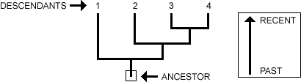
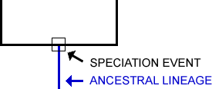
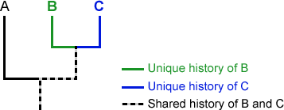
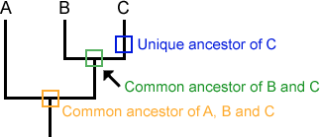
Reading Phylogenetic Tree
Reading a tree is similar to a family tree, it is a tracing descendants from ancestors
When a split occurs this represented as a branching event on the phylogeny
Following the branch of each taxa shows both its unique and shared evolutionary history
Each lineage has ancestor shared with other taxa and ancestors unique to that lineage only

Slide 23
Trees are NOT ladders
A very common misrepresentation of both evolution and phylogenetic trees is that they are ladder like

Slide 24
Trees are NOT ladders
A very common misrepresentation of both evolution and phylogenetic trees is that they are ladder like
Evolution is often mistakenly viewed as a continual linear progression of advancement or improvement.
This is termed “ladder thinking” where as you move along a ladder you move higher along a scale of advancement -> an INCORRECT view of evolution

Slide 25
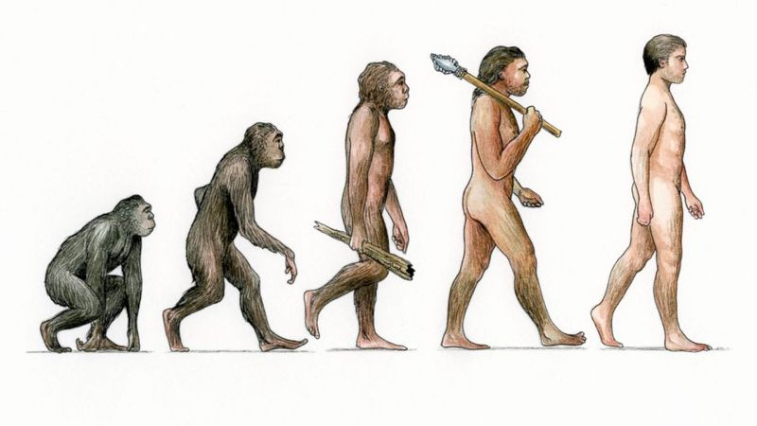
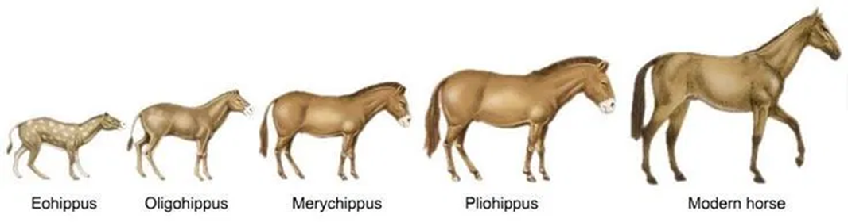
Trees are NOT ladders
A very common misrepresentation of both evolution and phylogenetic trees is that they are ladder like
Evolution is often mistakenly viewed as a continual linear progression of advancement or improvement.
This is termed “ladder thinking” where as you move along a ladder you move higher along a scale of advancement -> an INCORRECT view of evolution
https://returntofreedom.org/wild-horse-nation/evolution/
https://au.news.yahoo.com/human-evolution-questioned-big-brain-gene-found-humans-not-chimps-26459188.html

Slide 26
Trees are NOT ladders
A very common misrepresentation of both evolution and phylogenetic trees is that they are ladder like
Evolution is often mistakenly viewed as a continual linear progression of advancement or improvement.
This is termed “ladder thinking” where as you move along a ladder you move higher along a scale of advancement -> an INCORRECT view of evolution
https://returntofreedom.org/wild-horse-nation/evolution/
https://au.news.yahoo.com/human-evolution-questioned-big-brain-gene-found-humans-not-chimps-26459188.html

Slide 27
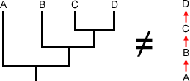
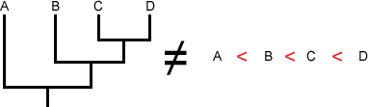
Tree Thinking
These trees are NOT saying that:
A turned into B, then B turned into C and D
A is less evolved/advanced than B or C or D
These trees ARE saying:
There was a species that existed at one point in time that diverged into taxa A and into the clade that includes B,C, and D
A, B, C, and D all share a single common ancestor
B, C, and D share an ancestor
C and D share an ancestor

Slide 28
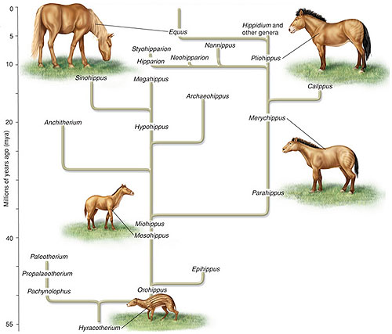
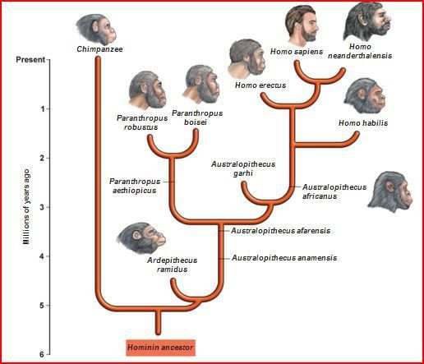
Back to Horses and Humans
https://calaski.wordpress.com/science-units/biological-evolution-unit/natural-selection/horse-evolution-tree/

Slide 29
Constructing the phylogeny
Phylogenies are built off shared characteristics
In phylogenetics characteristics are simply called characters
Characters are heritable traits that can be compared across organisms
These can be morphological, genetic, and even behavioral
A shared character is a trait that two or more lineages have in common
A derived character is a trait that a specific lineage has that is used to characterize that lineage specifically

Slide 30
Constructing the phylogeny
Understanding Evolution. 2020. University of California Museum of Paleontology. 8 August 2020 <http://evolution.berkeley.edu/>.

Slide 31
Constructing the phylogeny
Example shared vs derived characters
Shared character: internal skeleton or endoskeleton
Derived Character: Boney endoskeleton
Understanding Evolution. 2020. University of California Museum of Paleontology. 8 August 2020 <http://evolution.berkeley.edu/>.

Slide 32
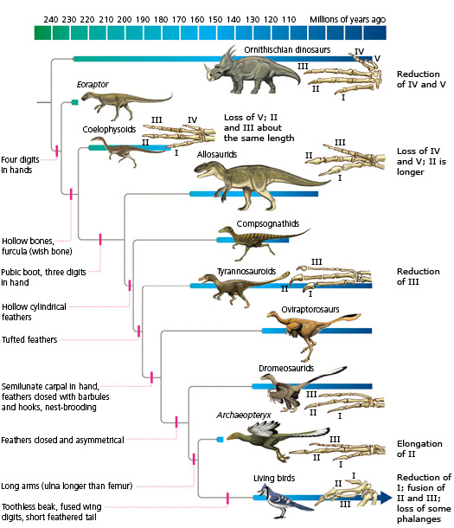
Constructing the phylogeny
Understanding Evolution. 2020. University of California Museum of Paleontology. 8 August 2020 <http://evolution.berkeley.edu/>.
Understanding Evolution. 2020. University of California Museum of Paleontology. 8 August 2020 <http://evolution.berkeley.edu/>.

Slide 33
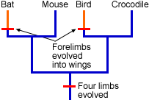
Homologous Vs. Analogous characters
When using shared characters to infer phylogeny it is imperative to use homologous characters
These a characteristics that have shared origin
Whereas, an analogous character is a character that serves a similar purpose but has separate origins
Wings in flying animals is a classic example
Understanding Evolution. 2020. University of California Museum of Paleontology. 8 August 2020 <http://evolution.berkeley.edu/>.

Slide 34
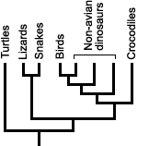
A tree-based classification system
Evolutionary biologists typically use a classification system based on shared evolutionary history amongst clades
Remember for a clade to be valid it must include all descendants and their common ancestors
Understanding Evolution. 2020. University of California Museum of Paleontology. 8 August 2020 <http://evolution.berkeley.edu/>.

Slide 35
A tree-based classification system
Evolutionary biologists typically use a classification system based on shared evolutionary history amongst clades
Remember for a clade to be valid it must include all descendants and their common ancestors
MONOPHYLETIC
Understanding Evolution. 2020. University of California Museum of Paleontology. 8 August 2020 <http://evolution.berkeley.edu/>.

Slide 36
A tree-based classification system
Evolutionary biologists typically use a classification system based on shared evolutionary history amongst clades
Remember for a clade to be valid it must include all descendants and their common ancestors
MONOPHYLETIC
Understanding Evolution. 2020. University of California Museum of Paleontology. 8 August 2020 <http://evolution.berkeley.edu/>.

Slide 37
A tree-based classification system
Evolutionary biologists typically use a classification system based on shared evolutionary history amongst clades
Remember for a clade to be valid it must include all descendants and their common ancestors
MONOPHYLETIC
A “clade” that include the descendants but not all the ancestors is called a Polyphyletic clade; therefore not a true clade
A polyphyletic clade need to be renamed to reflect the appropriate evolutionary history
Understanding Evolution. 2020. University of California Museum of Paleontology. 8 August 2020 <http://evolution.berkeley.edu/>.

Slide 38
A tree-based classification system
Evolutionary biologists typically use a classification system based on shared evolutionary history amongst clades
Remember for a clade to be valid it must include all descendants and their common ancestors
MONOPHYLETIC
A “clade” that include the descendants but not all the ancestors is called a Polyphyletic clade; therefore not a true clade
A polyphyletic clade need to be renamed to reflect the appropriate evolutionary history
Understanding Evolution. 2020. University of California Museum of Paleontology. 8 August 2020 <http://evolution.berkeley.edu/>.

Slide 39
A tree-based classification system
Evolutionary biologists typically use a classification system based on shared evolutionary history amongst clades
Remember for a clade to be valid it must include all descendants and their common ancestors
MONOPHYLETIC
A “clade” that include the descendants but not all the ancestors is called a Polyphyletic clade; therefore not a true clade
A polyphyletic clade need to be renamed to reflect the appropriate evolutionary history
Understanding Evolution. 2020. University of California Museum of Paleontology. 8 August 2020 <http://evolution.berkeley.edu/>.

Slide 40
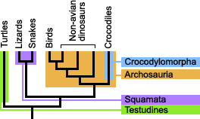
Tree based classification system
Here you will see different monophyletic clades and the names given to each
Understanding Evolution. 2020. University of California Museum of Paleontology. 8 August 2020 <http://evolution.berkeley.edu/>.

Slide 41
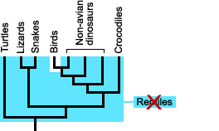
Tree based classification system
Here is a diagram of what we commonly refer to as reptiles or at least how it is has been taught is school for a long time
There is a problem here, though, with two solutions
Understanding Evolution. 2020. University of California Museum of Paleontology. 8 August 2020 <http://evolution.berkeley.edu/>.

Slide 42
Tree based classification system
Here is a diagram of what we commonly refer to as reptiles or at least how it is has been taught is school for a long time
There is a problem here, though, with two solutions
Reptile (as is commonly taught) is not a valid classification because it a polyphyletic clade if you exclude birds. Therefore, should be reclassified.
Or birds should be considered reptiles
This is actually the way many evolutionary biologists consider it
Understanding Evolution. 2020. University of California Museum of Paleontology. 8 August 2020 <http://evolution.berkeley.edu/>.

Slide 43
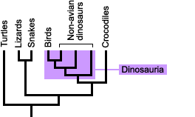
Tree based classification system
Using this form of classification also places birds within the dinosaur clade
So the little bird chirp outside your window is actually a little dinosaur chirping outside your window!
Understanding Evolution. 2020. University of California Museum of Paleontology. 8 August 2020 <http://evolution.berkeley.edu/>.

Slide 44
Molecular Phylogenetic
The sub-discipline of phylogenetics that uses genetic data to infer evolutionary histories i.e. phylogenies
Incorporation of genetic information has become the major focus of phylogenetic studies towards the end of the 1900’s
Morphological data is still used in addition to genetic
Fossils -> still don’t have any dino DNA
Has seen a lot of reclassification and reassessment of how we understand species relations and evolutionary histories of organisms
Hence: a phylogeny is a hypothesis
Prior morphological characters lead us one conclusion but in light of new information we have changed how we understand something i.e. The Scientific Method!!!!

Slide 45
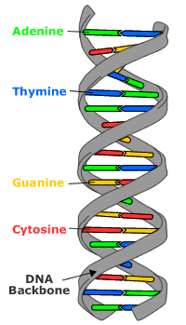
DNA and the Central Dogma of Biology
Composed of basic units
Adenine, Thymine, Guanine, Cytosine

Slide 46
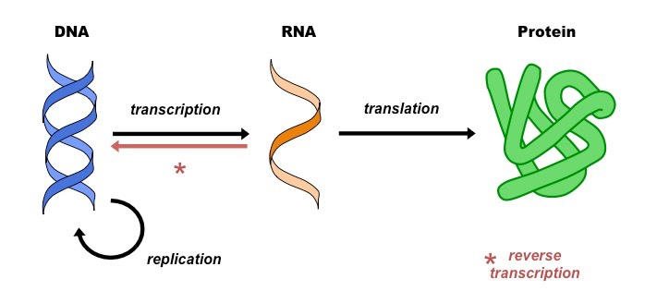
DNA and the central dogma of Biology
Composed of basic units
Adenine, Thymine, Guanine, Cytosine
The central dogma of biology
DNA -> RNA -> Protein
Code for RNA is packaged in DNA as a gene
https://ib.bioninja.com.au/welcome-to-the-bioninja/

Slide 47
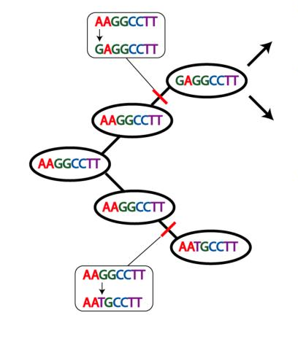
Goals of molecular phylogenetics
Changes in DNA as the heritable characters or traits past down across generations
Think back to the R. Dawkin quote from the begin of this
Characterize patterns in these traits across generations
What drives the changes in heritable DNA?
Notes:
Clarify that this is 100’s of thousands of times over, like we can only look at one trait (legs) but with genes, each position becomes a trait

Slide 48

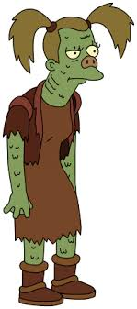
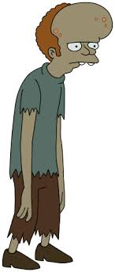
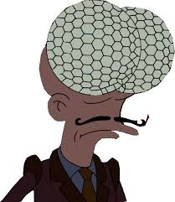
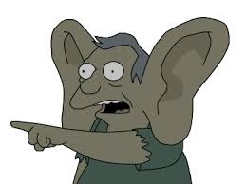
Mutation!

Slide 49
Mutation: as a heritable trait
A random (stochastic) process

Slide 50
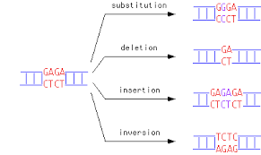
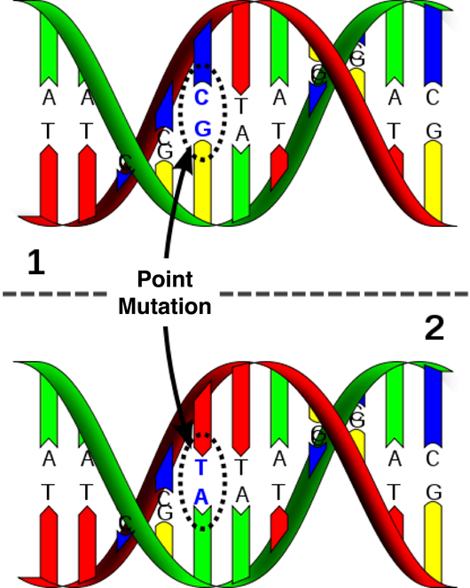
Mutation: as a heritable trait
A random (stochastic) process
Different types including point, insertion, deletion, translocation, others..

Slide 51
Mutation: as a heritable trait
A random (stochastic) process
Different types including: point, insertion, deletion, translocation, others..
The affect on the organism can be negative, positive, or neutral
In molecular phylogenetic studies which type are we typically interested in?

Slide 52
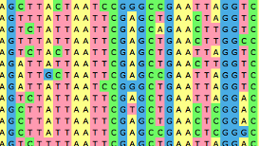
Identifying mutations
Multiple sequence alignments
Alignment of three or more sequences
Used to characterize differences between sequences
Infer homology of characters
Numerous methods
Progressive methods
Clustal family of algorithms
Iterative methods
MUSCLE algorithm

Slide 53
Identifying mutations
Multiple sequence alignments
Alignment of three or more sequences
Used to characterize differences between sequences
Infer homology of characters
Numerous methods
Progressive methods
Clustal family of algorithms
Iterative methods
MUSCLE algorithm

Slide 54
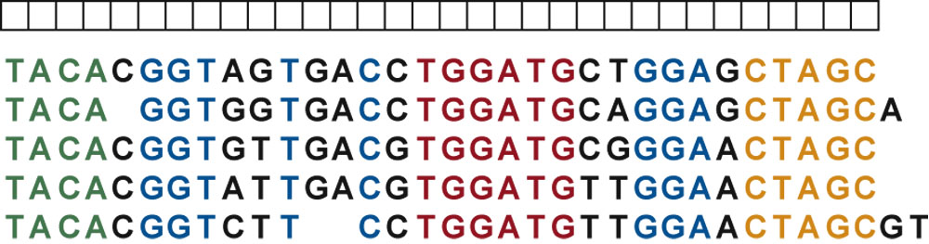
Sequence Alignment
5 different individuals
Notes:
Now we’re finally to sequence alignment. This is the arrangement of two or more sequences (nucleotide or protein sequences) that will highlight their similarities and differences.

Slide 55
Sequence Alignment
Gap

Slide 56
Sequence Alignment
Gap
Insertion

Slide 57
Sequence Alignment
Gap
Insertion
Deletion

Slide 58
Sequence Alignment
Gap
Insertion
Deletion
Indel

Slide 59
Sequence Alignment
Gap
Insertion
Deletion
Indel
Mismatch

Slide 60
Sequence Alignment
Gap
Insertion
Deletion
Indel
Mismatch
AATTCTGGCCCTCTCTTCCCGGGTTACGTCCTTTAAACAATTCCGGG
AATTCGGGCCCTCTCATCCCGGGAAATTACGTCGTTTAAACAATTCCGGG

Slide 61
Sequence Alignment
Gap
Insertion
Deletion
Indel
Mismatch
AATTCTGGCCCTCTCTTCCCGGGTTACGTCCTTTAAACAATTCCGGG
AATTCGGGCCCTCTCATCCCGGGAAATTACGTCGTTTAAACAATTCCGGG
AATTCTGGCCCTCTCGTCCCGGG---TTACGTCCTTTAAACAATTCCGGG
||||| ||||||||| ||||||| ||||||| ||||||||||||||||
AATTCCGGCCCTCTCATCCCGGGAAATTACGTCGTTTAAACAATTCCGGG
1 2 3 4 5

Slide 62
Sequence Alignment
Gap
Insertion
Deletion
Indel
Mismatch
AATTCTGGCCCTCTCTTCCCGGGTTACGTCCTTTAAACAATTCCGGG
AATTCGGGCCCTCTCATCCCGGGAAATTACGTCGTTTAAACAATTCCGGG
AATTCTGGCCCTCTCGTCCCGGG---TTACGTCCTTTAAACAATTCCGGG
||||| ||||||||| ||||||| ||||||| ||||||||||||||||
AATTCCGGCCCTCTCATCCCGGGAAATTACGTCGTTTAAACAATTCCGGG
1 2 3 4 5
Indel
From this alignment we don’t know if the indel is a result of an insertion in sequence or a deletion in the other

Slide 63
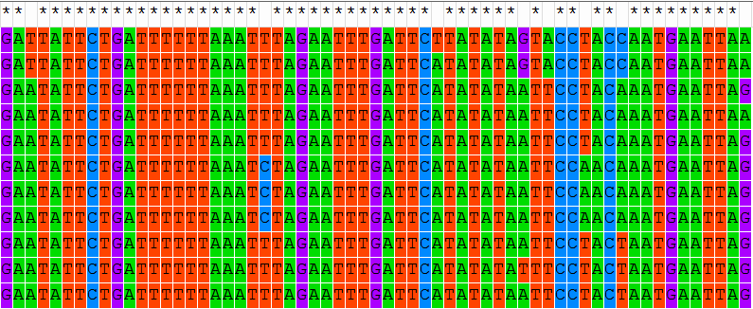

Slide 64
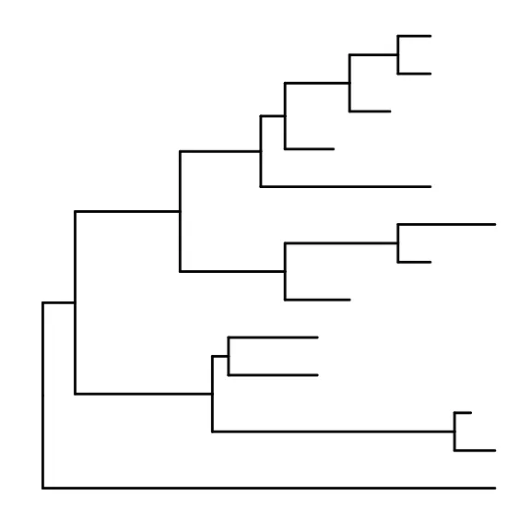

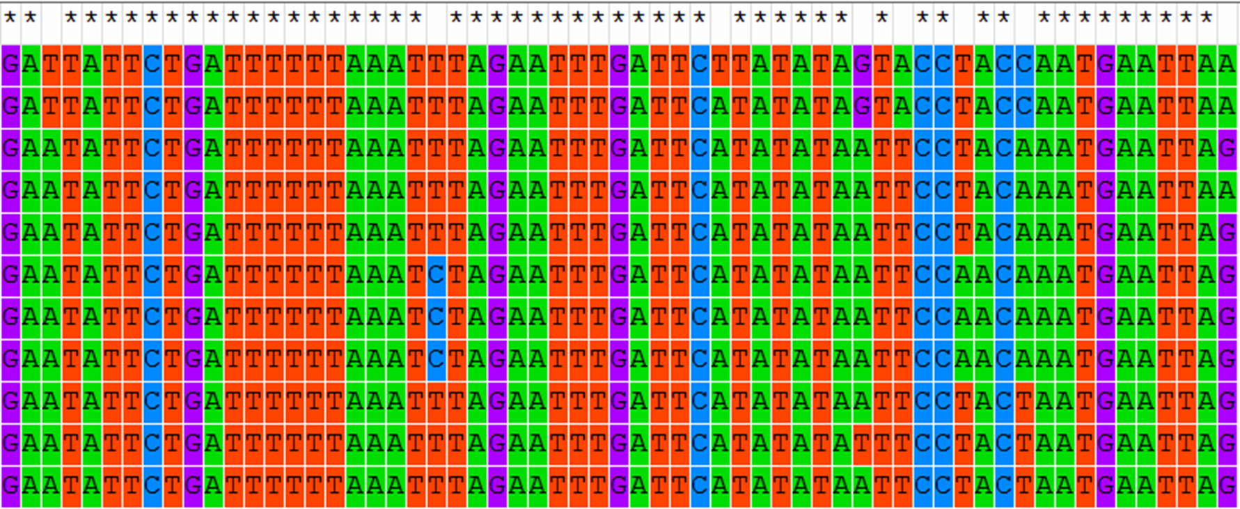
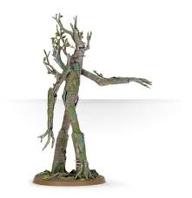
Back to the trees
+
=

Slide 65
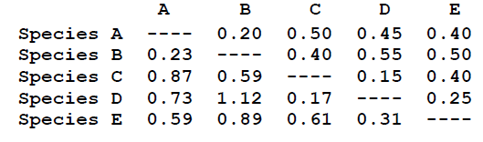
Two main construction methods
Distance Based:
Transform the sequence data into pairwise distances, and then use the matrix during tree building, ignoring characters
Methods: UPGMA and Neighbor Joining Tree

Slide 66
Two main construction methods
Distance Based:
Transform the sequence data into pairwise distances, and then use the matrix during tree building, ignoring characters
Character based:
Uses the differences in sequence characters to generate trees
Methods: UPGMA and Neighbor Joining Tree
Methods: Maximum Parsimony and Maximum Likelihood Trees

Slide 67
Back to the trees
Selecting your gene of interest
Gene that are highly conserved
Important to the function of the organism
Ensures that the majority of the mutation in the gene is neutral
How closely related are your species of interest?
Some genes are more appropriate for the level of difference you are interested in
You would not want to use four legs as a character for differentiating mice because they all have four legs
Head shape or tooth shape might be better
Distantly related species: RAG1, ODC, CMOS
More closely related: CYTB, COI, COII

Slide 68
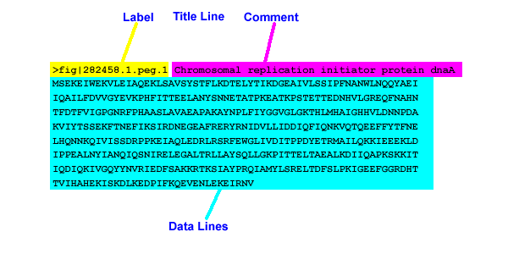
Fasta Format
Fasta Format

Slide 69
Fasta Format

Slide 70
Fasta Format

Slide 71

Data Source
GenBank Data Repository
Maintained by National Center for Biotechnology Information (NCBI)
MASSIVE repository of genetic data
MORE on this later!

Slide 72
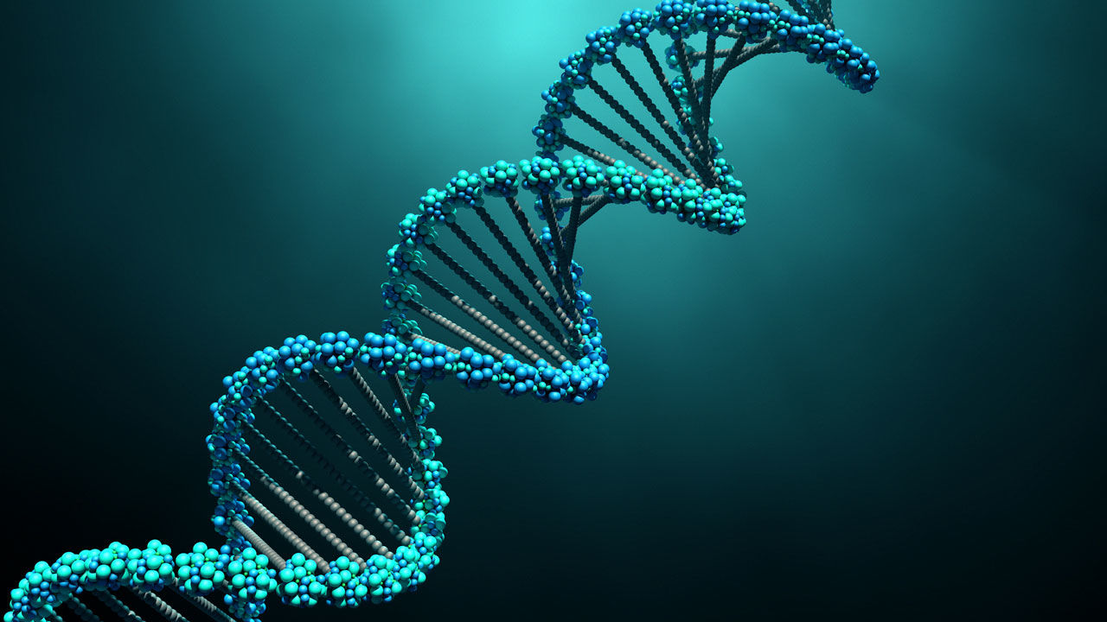
Today’s Activity
Constructing a phylogeny
with genetic data

Slide 73
RATTLESNAKES!!!!!!!!!!!
Morphological based phylogenic analyses define two major groups in the broader group of rattlesnakes
Crotalus
Rattlesnakes
Sistrurus
Agkistrodon
(outgroup)

Slide 74
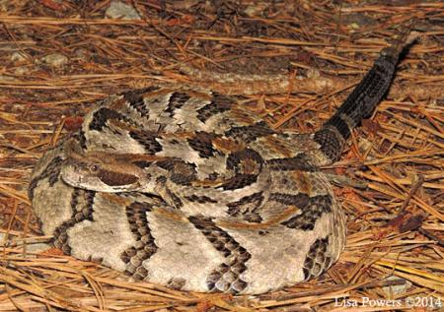
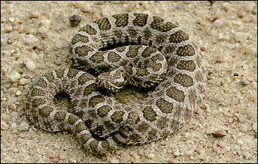
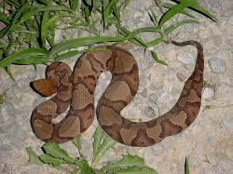
RATTLESNAKES!!!!!!!!!!!
Crotalus horridus
Canebrake / Timber Rattlesnake
Crotalus
https://kysnakes.ca.uky.edu/snake/crotalus-horridus
Sistrurus tergeminus
Massasauga
Sistrurus
https://en.wikipedia.org/wiki/Massasauga
Agkistrodon contortrix
Copperhead
Agkistrodon
(outgroup)

Slide 75
RATTLESNAKES!!!!!!!!!!!
QUESTIONS??
Does the genetic information support this hypothesis?
Are Crotalus and Sistrurus monophyletic clades?
Are there any species that might warrant further investigation with respect to how they are classified taxonomically?
Crotalus
Sistrurus
Rattlesnakes
Agkistrodon
(outgroup)

Slide 76
The Data
We will be using the gene Cytochrome b
CYTB
Part of electron transport chain
HIGHLY conserved gene
FASTA files obtained from GenBank
30 + species in dataset
Crotalus, Sistrurus, and Agkistrodon

Slide 77
The Data
The Steps
We will be using the gene Cytochrome b
CYTB
Part of electron transport chain
HIGHLY conserved gene
FASTA files obtained from GenBank
30 + species in dataset
Crotalus, Sistrurus, and Agkistrodon
Import data into MEGA7
Create multiple sequence alignment
Trim/truncate sequences
Create phylogenetic trees
Interpret trees

Slide 78
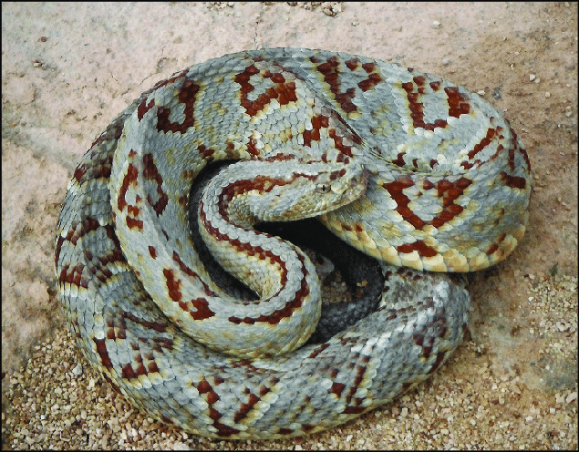
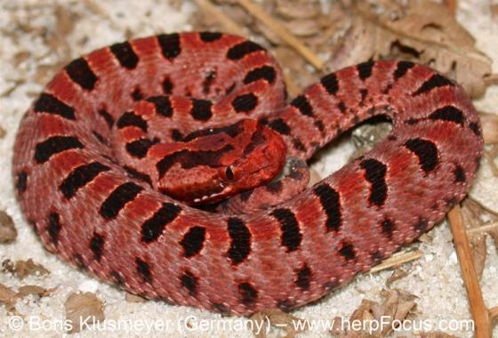
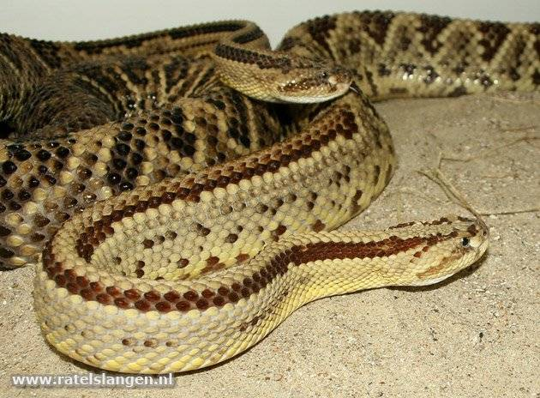








The Snakes
C. tzabcan
S. miliarius
C. simus
S. tergeminus
https://www.researchgate.net/profile/Ruben_Carbajal_Marquez/publication/341098726/figure/fig2/AS:886607032881152@1588394997536/An-adult-male-Tzabcan-Rattlesnake-Crotalus-tzabcan-with-a-light-color-pattern-found-in.png
S. ravus
C. mitchellii
C. cerastes
C. durissus
C. atrox
C. lepidus
C. ornatus
C. horridus
http://www.californiaherps.com/snakes/pages/c.atrox.html
https://kysnakes.ca.uky.edu/snake/crotalus-horridus

